Slide 1
Topic : Trigonometry
EQ: What is the tan ratio and how can I apply it to right angled triangle ?

Slide 2
Mental Maths
If you are given the two sides of a right angled triangle that are not the hypotenuse, which trig function should you use ?
What is the symbol for the Greek letter theta ?

Slide 3
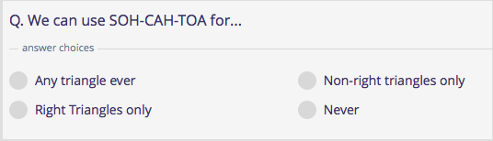
Mental Maths
Write a equation to represent the pythagorean theorem ?
We can use SOH-CAH_TOA for..

Slide 4
Real life applications of trigonometry
Carpenters can work out the angle of pitch when building a house roof.
Building surveyors can determine the heights of tower blocks.
Military ships can accurately position potential enemy submarines.

Slide 5

The Tan Rule for finding an angle

Slide 6

What is the tan ratio?

Slide 7
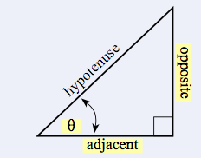
For example

Slide 8
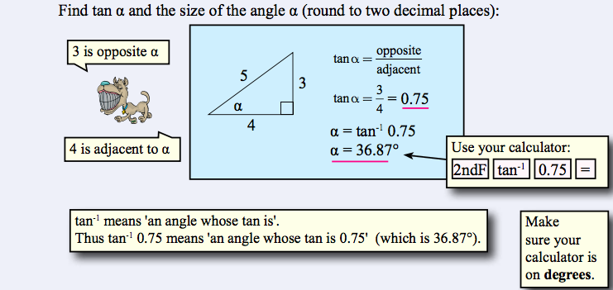
For example

Slide 9
The Tan Ratio examples
Now complete the worksheet.

Slide 10
Activity outside
If time permits please head outside to the area in front of the sports building. Using a trundle wheel, measure the distance along the width of the undercover sports area. The school’s architect recorded a vertical roof height of 3 metres above the horizontal in the roof space. Calculate the roof pitch of the undercover sports block and determine if the roof pitch exceeds the minimum WA building standards in relation to commercial water run-off ( 5 degrees ).

Slide 11
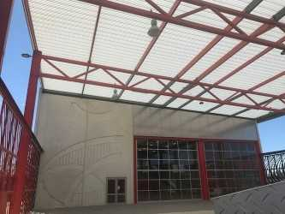
Activity Outside

